Slide 1
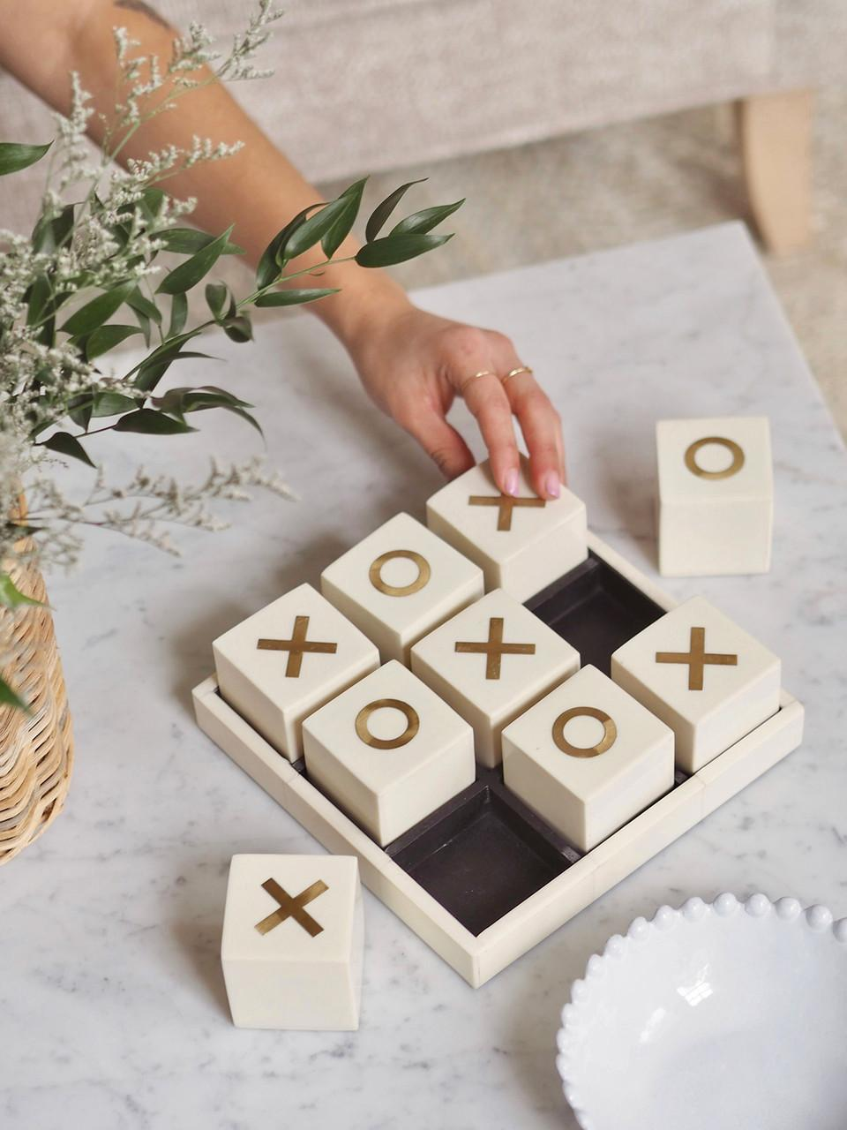
Tic – Tac – Toe

Slide 2
Team - 02
Members
Divya Bhupatbhai Lakhani
Nirav Arvindbhai Patel
Nikhil
Le Nhat Minh Quan
Kushani Lakshika Gimhani Abeykoon Mayandige

Slide 3
Why we choose this game?
Easy to learn: Tic Tac Toe is a simple game that can be learned in minutes. Players need only know the basic rules of the game.
Enhances strategic thinking: Despite its simplicity, Tic Tac Toe requires players to think ahead and develop strategies to win.
Improves cognitive abilities: Playing Tic Tac Toe can help improve cognitive abilities such as memory, attention, and visual perception.
Promotes social interaction: Tic Tac Toe is a fun game that can be played with friends or family members. It promotes social interaction, communication, and teamwork.

Slide 4
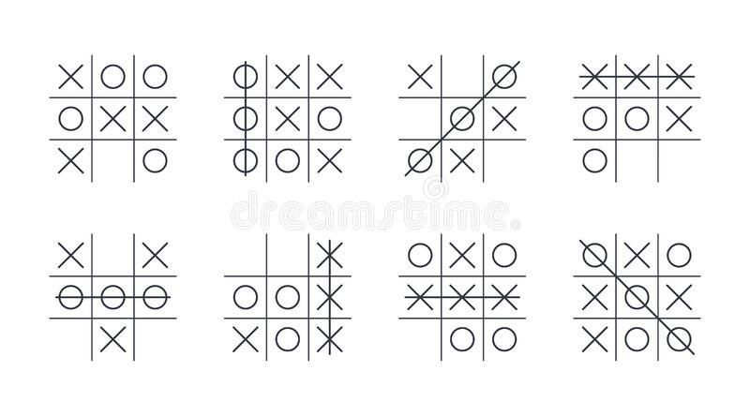
How to play the game?
Tic Tac Toe is a simple two-player game. Here are the steps to play the game:
There is a board with 3x3 grid.
One player chooses an X and the other player chooses an O.
The first player places their symbol in any empty square on the grid.
The second player places their symbol in any remaining empty square on the grid.
Players take turns placing their symbols until one player has three in a row (horizontally, vertically or diagonally), or all squares are filled.
If a player gets three in a row, they win the game. If all squares are filled and no player has three in a row, the game ends in a tie.

Slide 5
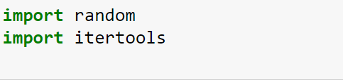

Creating Code
Step 1 - Import Libraries.
Step 2 - Create Board.

Slide 6

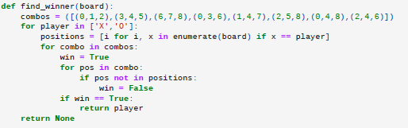
Creating Code
Step 3 - Create function to print board.
Step 4 - Create function to determine winner.

Slide 7
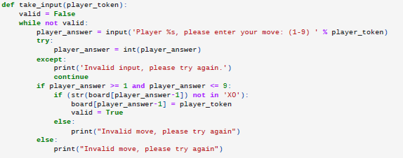

Creating code
Step 5 - Create function to take input from players.
Step 6 - Create function to switch player.

Slide 8
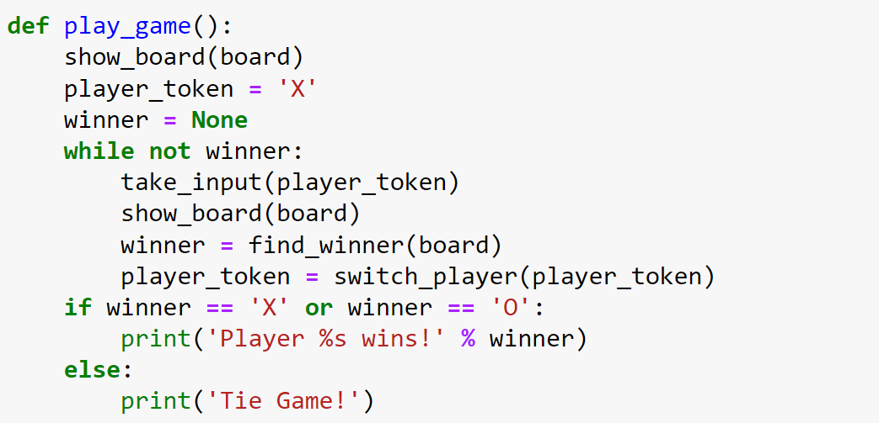

Creating code
Step 7 - Create main function to run the game.
Step 8 - Run the game.

Slide 9
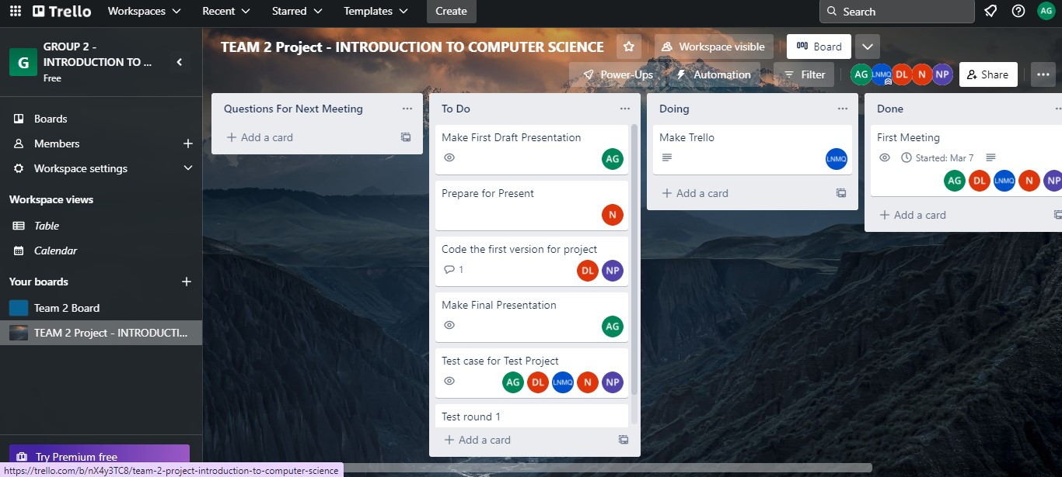
About Teamwork
Firstly, we created WhatsApp group including all team members.
Using WhatsApp group, we Scheduled Zoom meeting.
During the 1st Zoom meeting we decided how to do this task as a team & chose the project topic
After the 1st Zoom meeting, we create new board in Trello for list down our works.
In the 2nd Zoom meeting, we tested our code and prepared for the presentation.

Slide 10
Achievements
Developed strong communication skills.
Plan and manage time.
Break complex tasks into parts and steps.
Refine understanding through discussion and explanation.
Learned academic things from peers (Python, GitHub, Trello).

Slide 11
Links
Trello Board:
https://trello.com/invite/b/nX4y3TC8/ATTI34cb560d3bd2f0f1893e5a392948c7747279C669/team-2-project-introduction-to-computer-science
Github:
https://github.com/o0akin0o/INTRODUCTION-TO-COMPUTER-SCIENCE

Slide 12


